Slide 1
Torino .NET Meetup Azure App Configuration and Azure Key Vault
16 Marzo 2022

Slide 2
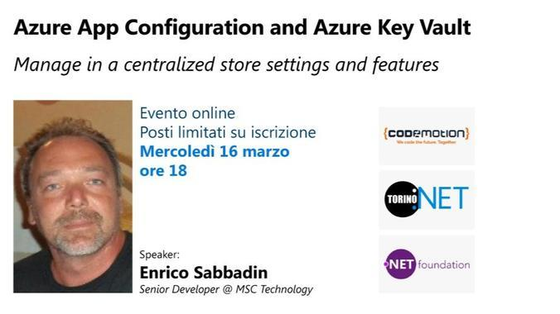
torino .net meetup

Slide 3
Azure app configuration and Azure key vault
Overview
App configuration basics
App configuration authentication / authorization
Azure App Configuration as .NET configuration provider
Azure Key Vault (AKV) Basics
AKV authentication / authorization
AKV Secrets as .NET configuration provider
AKV references in Azure app configuration .NET configuration provider
Integration in Azure DevOps pipelines
Git and Secrets

Slide 4
App configuration: Overview
Paas service to store key values pairs to centralize settings and feature flags
Dynamically change application settings without redeploy or restart an application
Strong separation between configurations and code artifact/package
Works as configuration provider for dotnet and dotnetcore
As any (many?) other azure resource, can be managed using
REST API
SDK for different languages
Az cli
Powershell module
Azure portal

Slide 5
App configuration: Overview
Internal flat structure, but prefixes and labels allow for filtering and logical hierarchies
Allows storage of strings with an optional content type
A json string in a single slot with proper content type can be deserialized in a complex .NET configuration object

Slide 6
Feature management
Offers as a “sub module” a feature management store
SDK offers high level abstraction to customize apps according to feature flags value
Code
controllers' method attribute
mvc tag helpers
Can be static, time range based, targeting (percentage or by group/user)
Implement IFeatureFilter for complex evaluation

Slide 7
App configuration in Azure Portal
DEMO
Configuration explorer
Feature management
Metrics

Slide 8
App configuration authentication
Access keys
Azure AD credentials
Users, Groups
Service principals
Secrets, certificates
Managed identities

Slide 9
App configuration authorization
Access keys
Read and write
Azure AD: Standard Azure approach RBAC based
RBAC: App Configuration Data Owner, App Configuration Data Reader
Assign to principal at the app configuration level or above

Slide 10
Azure App Configuration as .NET configuration provider
Add proper nuget packages
Plug app configuration in app startup
DEMO:
app-config-basic
basic keys, “complex” keys
app-config-refresh
Key refresh
app-config-provider-order
How to: app.config wins over app configuration

Slide 11
App Configuration High-Availability
Azure App Configuration is a regional service
Each configuration store is created in a particular Azure region. A region-wide outage affects all stores in that region. App Configuration doesn't offer automatic failover to another region.
public static IHostBuilder CreateHostBuilder(string[] args) => Host.CreateDefaultBuilder(args) .ConfigureWebHostDefaults(webBuilder => webBuilder.ConfigureAppConfiguration((hostingContext, config) => { var settings = config.Build();
config .AddAzureAppConfiguration(settings["ConnectionString_SecondaryStore"], optional: true) .AddAzureAppConfiguration(settings["ConnectionString_PrimaryStore"], optional: true); }) .UseStartup<Startup>());

Slide 12
Azure Key Vault: Basics
Secrets Management
Key Management
Certificate Management
provision, manage, and deploy public and private Transport Layer Security/Secure Sockets Layer (TLS/SSL) certificates
As App configuration, it can be managed via portal, az cli, sdk, REST, powershell
HA: Content is replicated within a region and to a secondary region

Slide 13
Azure portal
Azure Key Vault in Azure Portal
Keys, Certificates, Secrets
Metrics

Slide 14
Key Management
create and control the encryption keys used to encrypt your data
software-protected: asymmetric encryption only
hardware-protected asymmetric and symmetric encryption (HSM)
#az keyvault key create --vault-name msc-key-vault-session --name mykey1 --size 2048
# anyone can do this ..
$x= az keyvault key encrypt --name mykey1 --vault-name msc-key-vault-session --value $secret --data-type plaintext --algorithm RSA-OAEP | ConvertFrom-Json
write-host "encrypted " $x.result
# only allowed principals can do this
$y= az keyvault key decrypt --name mykey1 --vault-name msc-key-vault-session --value $x.result --data-type plaintext --algorithm RSA-OAEP | ConvertFrom-Json
write-host "decripted " $y.result

Slide 15
Secrets Management
Key Vault stores and manages secrets as sequences of octets (8-bit bytes), with a maximum size of 25k bytes each
All secrets in your Key Vault are stored encrypted
The Azure Key Vault service encrypts your secrets when you add them, and decrypts them automatically when you read them.
In addition to the secret data, the following attributes may be specified:
exp, nbf, enabled, contentType Read only : Created, updated
By default, Key Vault allows access through public IP addresses. You can also restrict access to specific IP ranges, service endpoints, virtual networks, or private endpoints.

Slide 16
AKV authentication
NO ACCESS KEYS
Azure AD credentials
Users, Groups
Service principals
Secrets, certificates
Managed identities
Use Managed identities whenever possible

Slide 17
AKV authorization
Standard RBAC with AKV dedicated roles
Allows fine grained control at key/secret/Certificate level
AKV policies : AKV specific authorization model
Can be applied only at key, secret or certificate level
Show on the azure portal

Slide 18
Azure App Configuration & AKV references to secrets
App configuration has no Access to AKV .. It just get a reference. Caller must have rights to read from AKV
App
Azure App Configuration
Azure Key Vault
Settings
Secrets
1) Get values (settings + key vault references)
Values
Key vault references
2) Get values for keys that are key vault reference

Slide 19
AKV as .NET configuration provider
DEMO
AKV Only
AKV references in App configuration
Access App configuration without access keys

Slide 20
Avoiding secrets in GIT 1/2
Where do you take the secrets value from, when you push them to AKV in your deploy pipeline ?
1) Use Azure Devops secrets variable
Poor history, not GitOps oriented
2) Store secrets in Git encrypted using AKV keys
Anyone can encrypt
Only principal used to deploy in azure devops has rights to decrypt right before pushing the value to AKV

Slide 21
Avoiding secrets in GIT 2/2
In Dev environment it’s not very practical to reference a shared development app configuration / AKV instances
One developer change affects another developer
In Dev machines, try not use nor app configuration nor AKV, instead use secrets configuration provider
They are stored in plain text in a file, but the file is out of git folder root
Share among devs using you company password keeper
If you opt for having the developer env accessing App config and keyvault, consider custom config provider configuration order
app.config/secrets providers wins over app config and keyvault
allow a developer to overwrite settings coming from a shared app config/akv

Slide 22
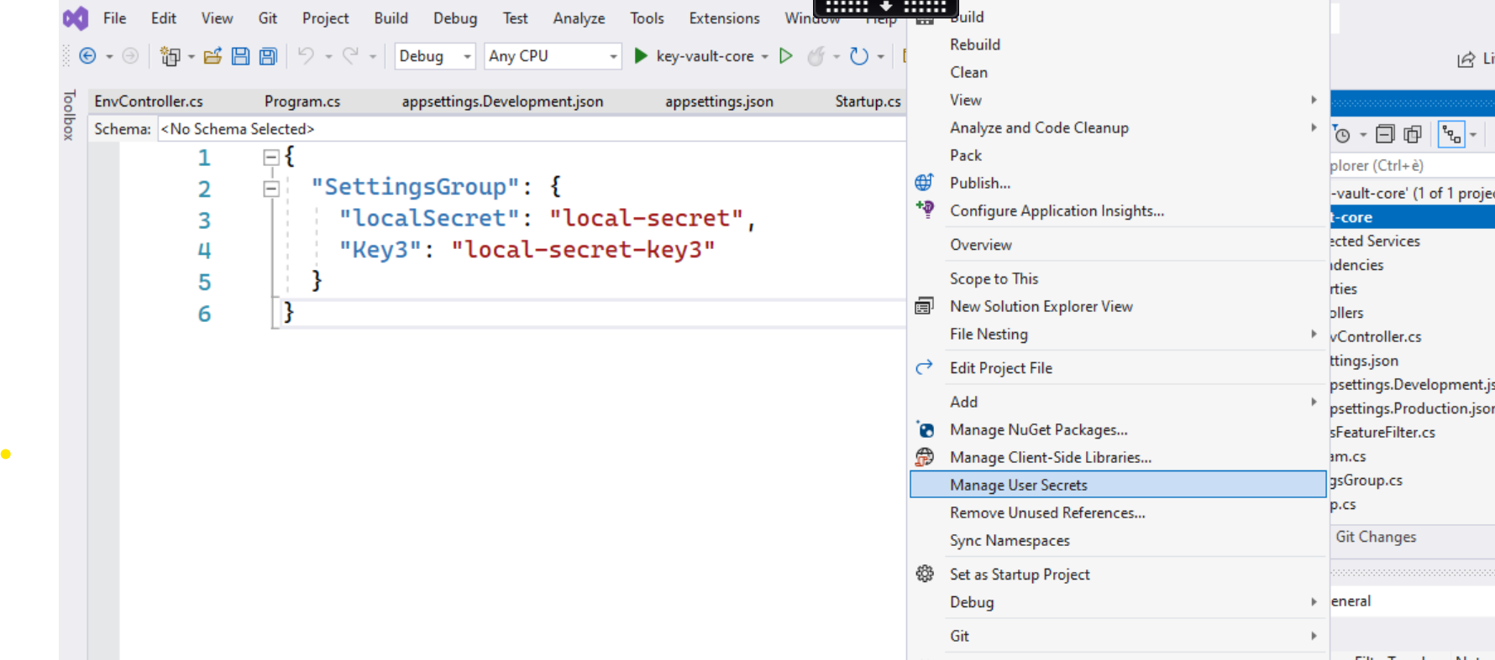
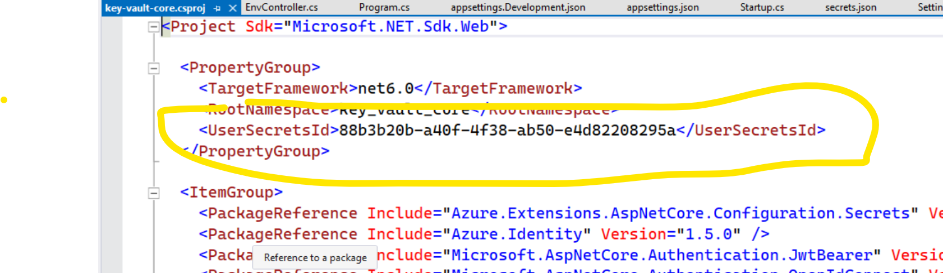
Local secrets provider in dev machine
C:\Users\enrico.sabbadin\AppData\Roaming\Microsoft\UserSecrets\88b3b20b-a40f-4f38-ab50-e4d82208295a

Slide 23
Local secrets provider in dev machine
DEMO
Control provider order
local-secrets

Slide 24
Best practice
https://docs.microsoft.com/en-us/azure/key-vault/general/best-practices
Use one app configuration / key vault instance per “application” and environment
Avoid authorization model with permission at secret, keys level
https://docs.microsoft.com/en-us/azure/azure-app-configuration/howto-best-practices
Do not use connection string, but leverage principals + RBAC (managed identity whenever possible)
Fine tune refresh timeout, use sentinel key
Use 2 instance for HA

Slide 25
BUG in akv config provider for dotnetframework
Race condition in provider setup
https://github.com/aspnet/MicrosoftConfigurationBuilders/issues/189
Work-around
<builders> <add name="AzureKeyVault" preloadSecretNames="false" Uri=“…” type=“...” /> </builders>

Slide 26

We are hiring
https://www.msc.com/tech-italy

